Slide 1

Ethereum Blockchain
Aamir shahzad
Application developer blockchain
Notes:
My Name is AAMIR Shahzad.
I am Application Developer Blockchain at IBM
Today in this session we are going to talk about Ethereum Blockchain.

Slide 2
Content
Introduction to Ethereum
Bitcoin history
Ethereum history
Ethereum vs Bitcoin
Hyperledger vs Ethereum
Algorithms used in Ethereum
Ethereum Philosophy
Develop a DEMO voting app
Notes:
The thing we are going to look at
What is Ethereum
A little bit about Bitcoin and Ethereum history
Then we will see what are technical difference between two
After that we will compare Hyperledger and Ethereum
Then we will talk about different Ethereum algorithms POW, POS, ECDSA and how they are used
Then comes Ethereum philosophy
In the end we will develop an app using Ethereum Blockchain

Slide 3
What is Ethereum
Ethereum is decentralized
deliver programming functionality
Turing complete programming environment
second most valued cryptocurrency today
Notes:
etherium is a decentralized platform that enables business logic to be implemented on the blockchain with the aid of smart contracts these contracts are executed on a decentralized computer called the etherium virtual machine which lies at the heart of the etherium architecture the developers at etherium have always advertised themselves as the future of the internet and a lot of people seem to agree too with its simple and generalized protocols an easy to non scripting language aetherium has become a platform thriving with use cases of decentralized applications for

Slide 4
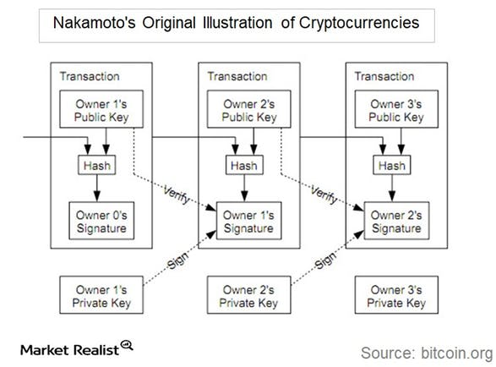
Bitcoin History
Satoshi Nakamoto
in 2009
decentralized digital currency
Transactions are verified by network nodes
recorded in a public distributed ledge
exchanged for other currencies, products, and services
1 bitcoin worth 9480.14$
Notes:
bitcoins was created after the 2008 financial crisis with a vision to remove the dependencies on third parties to facilitate the transaction
It began in 2007 with a crisis in the subprime mortgage market in the United States, and developed into a full-blown international banking crisis with the collapse of the investment bank Lehman Brothers on September 15, 2008

Slide 5
Ethereum Histroy
in late 2013 by Vitalik Buterin
initially described in a white paper
Bitcoin needed a scripting language
proposed development of a new platform
basic idea of putting executable smart contracts
2016 DAO hack
Ethereum(ETH) and Ethereum classic(ETS)
Notes:
Ethereum was initially described in a white paper by Vitalik Buterin,[10] a programmer involved with Bitcoin Magazine, in late 2013 with a goal of building decentralized applications.[11][12] Buterin had argued that Bitcoin needed a scripting language for application development. Failing to gain agreement, he proposed development of a new platform with a more general scripting language.[4]:88
Ethereum was proposed in late 2013 by Vitalik Buterin, a cryptocurrency researcher and programmer. Development was funded by an online crowdsale that took place between July and August 2014.^{[4]} The system then went live on 30 July 2015, with 72 million coins "premined". This accounts for about 68 percent of the total circulating supply in 2019. ^{[5]}
In 2016, as a result of the exploitation of a flaw in The DAO project's smart contract software, and subsequent theft of $50 million worth of ether,^{[6]} Ethereum was split into two separate blockchains – the new separate version became Ethereum (ETH) with the theft reversed,^{[7]} and the original continued as Ethereum Classic(ETC).^{[8]}

Slide 6
Ethereum vs Bitcoin
Ether
Run state of EVM, traded on exchange
Two type of accounts
EOA
Contract Account
Turing complete programming
5 time faster
Proof of work Ethash
Merkle Patricia Tree
Bitcoin
payment system
UTXO (where coins are flowing)
Built in scripting language
3 transaction/sec
Proof of work SHA256
Merkle tree
Notes:
six parameters cryptocurrency, accounts ,smart contracts ,transaction , consensus
just like bitcoins a Ethereum also has a digital currency
developed you will see that bitcoins was created after the 2008 financial crisis with a vision to remove the dependencies on third parties to facilitate the transaction and hence
on the other hand serves two main purposes firstly it is a cryptocurrency that is used to run the state machine of etherium so you see ether is a fuel that is used to pay for every single computational step
the invention of etherium makes it expensive to use up to too much of the blockchain Computers capacity
either is the fuel you need to run smart contracts
Account play central role. State of all account is state of Ethereum blockchain, account are essential for interaction with Ethereum blockchain , externally controlled accounts EOA maintain balance/Ether
CA, has, balance, store, associated code, => code execution is trigged by trasactions or message by other contract
Built in scripting language with few dozen operations, on other hand Ethereum has full general purpose language integrated in it
Unlike Bitcoin, Ethereum doesn’t have a fixed block size. Instead, each block on Ethereum has a gas limit that determines how many transactions can fit in a block. Ethereum has adjusted its gas limit over seven times since it launched in 2015.
bitcoins proof-of-work algorithm has some limitation the network is vast and growing and hence a transaction takes considerable amount of time to propagate in a network which causes the ambiguity in the network of Bitcoin
another limitation of Bitcoin is that since the - are the stakeholders or the network the top mining pools control is 75% of all the mining activity which causes the centralization in the system
to tackle this problem a theorem has adopted the ghost protocol

Slide 7
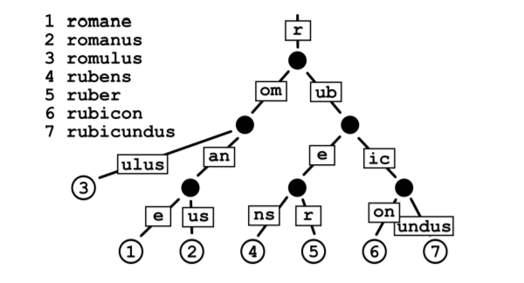
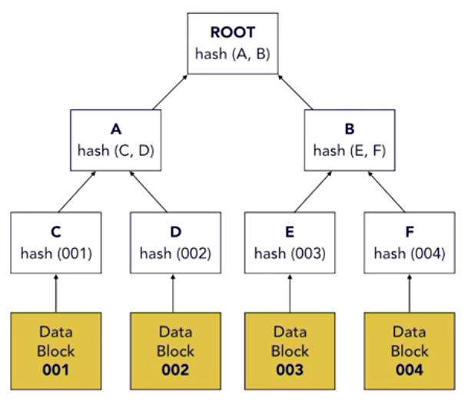
Patricia vs Merkle Tree
Notes:
A binary tree with hash pointers is called a Merkle tree. The leafs in the tree contain the data. The parent node, one level up in the tree, contains a hash of this data and is paired with another parent node. This continues all the way up to the root. In this way, the root node is the hash of all the data in the tree.The root hash can be used in public and it is relatively easy to verify that a certain data block is included in the Merkle tree.
A Patricia tree is a radix tree with a radix of 2. The data structure is mostly used to store strings or key-value pairs. Less space is needed in a Patricia tree, because any node that is an only child is merged with its parent. The stored string or key is the path taken from the root of the tree to a leaf.

Slide 8
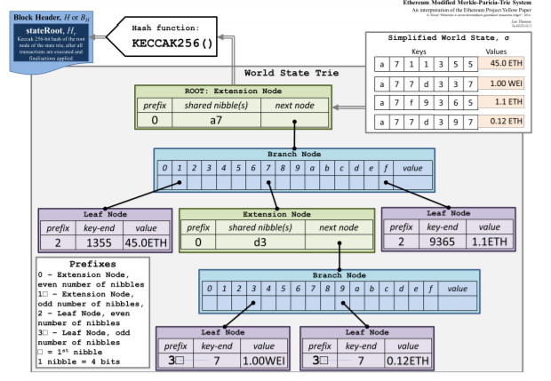
Merkle Patricia Tree
In this example, we store below key value pair in Merkle Patricia tree.
{ "a711355" : 45.0 , "a77d337": 1.00, "a7f9365": 1.1 , "a77d397": 0.12}
Merkle root hash is hash of the root node of the tree and KECCAK-256 hash algorithm is used to generate that hash.
Notes:
In this modified tree the keys are compared in hexadecimal form instead of
binary form. Both extension and leaf nodes contain a value which indicates the hex-prefix
encoding method. To make the tree cryptographically secure, the hash of a node
is used to reference it. This way, the hash of the root node makes a unique
identifier of the entire tree
•Branch node: The branch node is used when the keys have a different value. The branch nodes have a list of length 17. 16 elements for possible hex characters and the final element can hold a value if there is key that ends at that branch node. Thus a parent node is able to have 17 children instead of two in a normal Patricia tree.
• Extension node: This node is used when more than one key contains a shared part (called a nibble). The node keeps 2 values. The first value contains the part of a key that is shared among at least two different keys. The other value directs to the next node.
• Leaf node: A leaf node is used when there is only one key left that follows this path. The node keeps 2 values, one value for the last part of the key, which has not already been accounted for in previous branch nodes and extension nodes. The second value contains the actual value that is paired with the key.
In order to make such distinction, the MPT adds a prefix to the path. If the node is a leaf and the path consists of even number of nibbles, you add 0x20 as a prefix. If the path consists of odd number of nibbles, you should add 0x3 as a prefix. If the node is an extension node and the path consists of even number of nibbles, you add 0x00 as a prefix. If it consists of odd number of nibbles, you should add 0x1 as a prefix. Because the path that consists of an odd number of nibbles gets a nibble as prefix and the path that consists of an even number of nibbles gets two nibbles as a prefix, a path is always expressed as a byte.

Slide 9
Hyperledger vs Ethereum (Network Type)
Consortium/ permission blockchain
One can execute transaction in complete privacy and confidentiality
Public network
Every peer need to run consensus to validate transaction
Can participate in Ethereum network it you have computer and internet connection
All transactions are visible to all other nodes
Notes:
Compire on the basis of following parameters these parameters include Network type crypto currency consensus mechanism smart contracts language of development and maintenance
hyper ledger is an open source project under the Linux Foundation the hyper ledger project has various frameworks under its license like fabric aroma and indeed to name a few all these frameworks enable developers to provide blockchain based solutions for industrial and business-related problems
starting off with Network types well there are three different types of blockchain networks public private and consortium
public block chains are accessible by everybody with access to the Internet these networks need every ladder to run consensus to validate every transaction that occurs on the network
private blockchains are much more different they are only accessible by a limited number of participants as the name clearly suggests they may or may not even have a cryptocurrency involved with the network as
the network is made to tender to very specific needs a consortium blockchain also known as a permission blockchain is pretty similar to a private blockchain aside from its limited accessibility it also has levels of permission levied on the network by leveraging trust
in our case a theorem is a public blockchain network if you have a computer and an internet connection you can very well participate in the etherium network this also means that if you order to execute some secret transaction that you are really ashamed of it will be visible by everybody else on the network and thus your secret doesn't really remain a secret anymore
hyper ledger on the other hand is a consortium blockchain it was developed in such a way that you could execute those really embarrassing transactions in complete privacy and confidentiality

Slide 10
Hyperledgher vs Ethereum (Cryptocurrency)
No currency
Freedom to implement blockchain technology
If token is required it can be implemented
Ether (network specific coin)
Ether are used to pay for transaction and buy gas
Gas is used to pay for computation committed on evm
Notes:
talking about cryptocurrencies aetherium has its network specific coin called ether ether is mainly used to pay for transactions and to buy gas which is in turn used to pay for the computations committed on the evm new ethers are mined by miners who in turn validate the committed transactions -
ledger has no such specific coin - Asha gives the developers the freedom to implement blockchain technology however they want for their business with this said if a business beams it necessary that they need token or a coin for their purposes they can always implement one

Slide 11
Hyperledgher vs Ethereum (Consensus Mechanism)
Depend on developer it required consensus algorithm
(PBFT)Practical Byzantime Fault Tolerance
distributed network to reach consensus even when some of the nodes in the network fail to respond or respond with incorrect information
POW
Hash function is used to create condition
Using these condition participant announce conclusion
Then these conclusion verified by others
One who verify conclusion is rewarded
Notes:
In a distributed system, there’s a variety of threats that a consensus algorithm must be resilient against. Processes can crash. Machines and devices can fail. Network connections can be interrupted. Furthermore, since components of the system may be controlled by different organizations with different goals, they may act maliciously as well.
Consensus means all parties agree on a particular decision.
talking about consensus mechanism aetherium uses a proof-of-work mechanism for its consensus in a proof-of-work based algorithm a hash function is used to create conditions under which a single participant is permitted to announce their conclusion about the submitted information and then those conclusions can be verified by all other people in the system false conclusions are prevented by parameters of the hash function which ensure that false information will fail to compute in an acceptable manner in the etherium system the participants who publicly verify the transaction on behalf of the entire network are rewarded for their participation with newly created ether on the other hand
Hyperledgher allows developers to choose whether they require a consensus mechanism at all when they do choose to offer a consensus mechanism an algorithm called practical Byzantine fault tolerance is used which is also used in other popular blockchain platforms like ripple and Stella very roughly without explaining the whole algorithm
The Hyperledger Fabric architecture lets users choose an orderer service that implements a consensus algorithm that fits their application. One desirable property is Byzantine fault tolerance (BFT), which says the orderer can do its job even in the presence of malicious actors.
In order to get on the ledger in the first place, the transactions first have to get past endorsement policies and the endorsing peers that ran the transactions’ chaincode. (More details in a previous post.) Then after they’re on the ledger, the transactions are checked a final time by each peer’s validation step. Every step of the way, Fabric has a system in place to prevent bad things from happening.
Kafka in Hyperledger Fabric Ordering Service, RBFT in Hyperledger Indy, Sumeragi in Hyperledger Iroha, PoET in Hyperledger Sawtooth
the key difference between proof-of-work and PB FD is that in proof-of-work only one node rather the first node to solve the problem shouts out the answer unlike pbft which requires all the participating nodes in the consensus to return a decision
what ppfd does is as follows each node on the network maintains an internal state regarding ongoing specific information or status of the network when the node receives a message they use the message in conjunction with the internal state to run a computation this computation in return helps the node to arrive at a decision regarding the validity of the message after reaching its individual decision about the message it shares it with all other nodes in the network a consensus decision is determined based on the total decision submitted by all the nodes

Slide 12
Hyperledgher vs Ethereum
Language smart contract Go, java , python , js
Golang and java
Maintained by Linux foundation
Solidity , serpent
Written in golang and python
Maintained by Ethereum developer community
Notes:
moving on to smart contracts if helium and hyper ledger both allow business logic to be implemented with the aid of smart contracts
aetherium smart contracts are generally written in aetherium specific scripting languages like solitaire or serpent
ledgher contracts on the other hand are written in
chain code aside from that to run smart contracts on aetherium computation fee must be paid in the form of gas on the topic of language that each platform is written in aetherium uses a combination of golang and python while hypo ledger uses a combination of : and Java helium as a platform is maintained by the etherium developer community while hyper ledger comes under the linux foundation so much like other linux projects people from all over the world can help pipe eliezer get developed as a project now that we know the differences of both the platforms let's go through a use case of both of them for aetherium I'm going to show you all how voting can be made completely transparent the voter will submit his information to an identity verifier running on etherium with the help of smart contracts after the identity has been verified a token is generated with the water will enter into the ballot interface this token is unique and solves the problem of double voting in today's world the voter cast his vote and the sport is registered in a block on the blockchain network thus maintaining transparency and integrity of the voting system aetherium is preferred here as a platform over high polish due to its public nature which is integral for voting for our high pool as a use case I'll be explaining a truck racing scenario so that pharmacist knows where as medicines are being manufactured for Quality Assurance purposes it is important to note that there is no need for it to be public as that would mean revealing confidential applications between the pharmacist and the manufacturers every change in the medicines location storage type etc are stored on the blockchain these can also be automated with the help of Internet of Things sensors in this way the pharmacist and the patient both can verify the origin of the product and quality is assured a very similar business model is being used under the name hyper ledger saw tool to track fishers after harvest till the time they served on the table at a restaurant coming to the point of which platform is the best I personally don't think there is any best per se as implementations of each platform should be according to the specified business models in my opinion in the new future most business-to-business franchisee or b2b franchisee will be run on hyper ledger as they need to execute confidential obligations without passing everything through a central authority on the other hand aetherium will rule the world of business to customer or b2c Enterprise due to its global reach and public nature that's it from me today guys I hope you all learned something today about these two platforms goodbye I hope you have enjoyed listening to this video please be kind enough to like it and you can comment any of your doubts and queries and we will reply them at the earliest do look out for more videos in our playlist and subscribe to any Rekha channel to learn more happy learning

Slide 13
Ethereum Algorithms

Slide 14
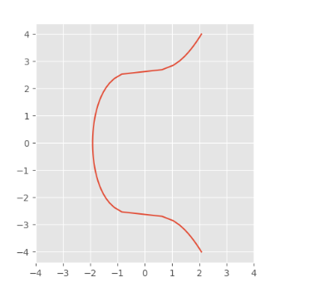
Ethereum Algorithm ECDSA
Secp256k1 curve (y² = x³ + 7)
private key
public key
User account address
Notes:
Elliptic Curve Digital Signature Algorithm or ECDSA is a cryptographic algorithm used by Bitcoin to ensure that funds can only be spent by their rightful owners. A few concepts related to ECDSA: private key: A secret number, known only to the person that generated it.
Ethereum uses the EDCSA algorithm with the secp256k1 curve. This is the same algorithm and curve that is used with Bitcoin. Generating the private key is done by randomly selecting a positive integer of 256 bits. With the private key, a public key can be generated and this key has a lentgh of 512 bits [41]. Ethereum uses a seperate address and not just the public key as an address. This address can be computed by hashing the public key and taking the last 160 bits of this hash [24]. This address represents the account of a user

Slide 15
Ethereum Algorithm Proof of work
Ethash
nonce
Proof-of-Work
Seed
16 MB cache
Dataset of 1 GB
Mining
find a nonce that is below a desired target value
Notes:
In English, a nonce is a number that can only be used once. In cryptography, a nonce is a one-time code selected in a random or pseudo-random manner that is used to securely transmit a main password, preventing replay attacks
In Ethereum, every transaction has a nonce. The nonce is the number of transactions sent from a given address. Each time you send a transaction, the nonce value increases by 1. There are rules about what transactions are considered valid transactions, and the nonce is used to enforce some of these rules.
• Seed: The seed is computed for each block by scanning through all block headers up until that particular block. The computation of the seed hashes (and datasets) can be done in advance, before the actual mining starts and it is recommended to mine faster and smoother.
• 16 MB cache: With the seed a pseudo random cache of 16 MB can be computed. The items in this cache are 64 byte values.
• Dataset of 1 GB: By using the previously generated cache, a dataset of 1 GB is generated. This dataset has the property that each item in it only depends on a small amount of items in the cache. This property makes the verification procedure easy and fast.
• Mining:
Ethash uses an initial 1 GB dataset known as the Ethash DAG and a 16 MB cache for light clients to hold. These are regenerated every 30,000 blocks, known as an epoch. Miners grab slices of the DAG to generate mix-hashes using transaction and receipt data, along with a cryptographic nonce to generate a hash below a dynamic target difficulty.

Slide 16
Ethereum Algorithm Proof of stake
Casper
Bonding and Bonded validators
security deposit min 32 ,max 13107
Chance chosen to propose the next block
validators’ code
Notes:
The proof of stake (PoS) seeks to address this issue by attributing mining power to the proportion of coins held by a miner. This way, instead of utilizing energy to answer PoW puzzles, a PoS miner is limited to mining a percentage of transactions that is reflective of his or her ownership stake. For instance, a miner who owns 3% of the Bitcoin available can theoretically mine only 3% of the blocks.
At the moment, the Proof-of-Stake algorithm is still in development and not everything is definitive. The developers of Ethereum are working on the consensus algorithm called ”Casper” [5]. Casper is a security-deposit based economic consensus protocol [43][22]. Bonded validators place a security deposit in order to participate in the consensus by proposing and producing blocks. There is a set of bonded validators. A validator is a user that participates in the mining process by validating transactions and creating blocks. A user can participate and become a validator in the set by depositing an amount of ether as stake.
The security deposit has to be someminimal amount of ether, now set on 32 and can be a maximum deposit of 131072. Depositing a stake is called bonding. After the deposit has taken place, the user is a bonded validator.
For each block, a list of validators is generated from the set of bonded validators. The list is pseudo-randomly chosen, with the randomness weighted by the amount of stake that a validator has initially deposited. Thus when a validator has deposited 10% of the total amount of deposited stake, he has a 10% chance at being chosen to propose the next block.
From this priority list, the first validator is allowed to propose a block.
All validators have a validators’ code. With this code they can check if the signatures in the block are valid. The validators need the validating code to verify the block they might accept in the chain. The code also applies as an identifier for the validator. After the proposal of a block, all of the validators still need to vote if that block will actually be accepted in the chain. The validators do this for blocks at every height (block number).
If a block does not get included in the chain, the validator that proposed the block will lose money equal to the block reward. Thus, validators will only make a block, if they are more than 50% sure that the block will be included. And thus, this way discourages validating blocks on multiple chains, because the validator will not gain anything and will only lose money. If a validator wants to withdraw, he needs to wait until the next epoch (a period of a large amount of block) and then he will get his deposit back, plus rewards minus penalties. The epoch length will be set on 10800 blocks and this will take about 12 hours. If something is not right, the validator will lose its deposit according to the slashing conditions [9]. These rules determine when a validator has misbehaved. For example, by voting for multiple blocks on the same height. If they have misbehaved their entire deposit will be removed.

Slide 17
Ethereum Philosophy
Simplicity
Universality
Modularity
Agility
Non-discrimination and non-censorship
Notes:
The Ethereum protocol should be as simple as possible, even at the cost of some data storage inefficiency or time inefficiency. An average programmer should ideally be able to follow and implement the entire specification, so as to eventually help minimize the influence that any specific individual or elite group can have on the protocol and furthering the vision of Ethereum as a protocol that is open to all. Optimizations which add complexity should not be included unless they provide very substantial benefit.
It is a fundamental part of Ethereum’s design philosophy that Ethereum does not have “features”. Instead, Ethereum provides an internal Turing-complete scripting language which you can use to construct any smart contract or transaction type that can be mathematically defined. Want to invent your own financial derivative? With Ethereum, you can. Want to make your own currency? Set it up as an Ethereum contract. Want to set up a full-scale Daemon or Skynet? You may need to have a few thousand interlocking contracts, and be sure to feed them generously, to do that, but nothing is stopping you.
Different parts of the Ethereum protocol should be designed to be as modular and separable as possible. Over the course of development, it should be easy to make a small protocol modification in one place and have the application stack continue to function without any further modification. Innovations such as Dagger, Patricia trees and RLP should be implemented as separate libraries and made to be feature-complete even if Ethereum does not require certain features so as to make them usable in other protocols as well. Ethereum development should be maximally done so as to benefit the entire cryptocurrency ecosystem, not just itself.
Details of the Ethereum protocol are not set in stone. Although we will be extremely judicious about making modifications to high-level constructs such as the C-like language and the address system, computational tests later on in the development process may lead us to discover that certain modifications to the algorithm or scripting language will substantially improve scalability or security. If any such opportunities are found, we will make use of them.
The protocol should not attempt to actively restrict or prevent specific categories of usage, and all regulatory mechanisms in the protocol should be designed to directly regulate the harm, not attempt to oppose specific undesirable applications. You can even run an infinite loop script on top of Ethereum for as long as you are willing to keep paying the per-computational-step transaction fee for it.

Slide 18
Ethereum Smart Contract
Smart contracts are blockchain class
In Ethereum write operation cause GAS -$ETH
Contract stored at address just like wallet
Original idea is to do some code the enable to put money in holding bin when certain parameter are met money transfer to other person
Smart contract save as bytes
Notes:
smart contracts are pre-written logic stored and replicated on a blockchain which is executed by a network of computer and can result and blockchain updates

Slide 19
How Ethereum work
Ethereum like bitcoin anyone can download it and run it
what really sets Ethereum apart is the inclusion of the Ethereum virtual machine (EVM)
EVM is like full LAMP or Mean stack
Ethereum blockchain will store data
EVM is app server that will handle smart contract and programming
Every Ethereum node runs the EVM to maintain consensus

Slide 20
Why need Ethereum GAS
Transactions in bitcoin are linear
Ethereum has proper programming language
Process in bitcoin is guaranteed to end but if program has loop and condition it can get stuck in infinite loop
In distributed decenderized system it can halt whole system
To solve this problem Vitalik came up with solution of GAS in ethereum

Slide 21
Ethereum Framework
Prerequisite for developing Ethereum app

Slide 22
Ethereum Truffle
A toolset for Ethereum
It allow compiling and building, testing, deployment and interaction
Test RPC local test framework
Implement Ethereumjs
Test accounts

Slide 23
MetaMask
browser extension
allows web applications to interact with the Ethereum blockchain
works as an Ethereum wallet
store and send any standard Ethereum-compatible tokens
run Ethereum DApps right in your browser without running a full Ethereum node
providing a user interface to manage your identities on different sites and sign blockchain transactions

Slide 24
Web3 — Ethereum Javascript API
A collection of libraries which allow you to interact with a local or remote ethereum node, using a HTTP or IPC connection
Communicate with an Ethereum node or transact with a smart contract deployed on the blockchain from inside a JavaScript or web application

Slide 25
References
https://medium.com/swlh/the-story-of-the-dao-its-history-and-consequences-71e6a8a551ee( DAO Hack)
https://www.youtube.com/watch?v=k_aVpSSx-Qg (DAO Hack)
https://medium.com/cybermiles/diving-into-ethereums-world-state-c893102030ed (Particia vs Merkle tree)
https://www.youtube.com/watch?v=fdWoNBt6CcY (Ethereum vs Bitcoin)
https://www.cs.ru.nl/bachelors-theses/2018/Lotte_Fekkes___4496426___Comparing_Bitcoin_and_Ethereum.pdf (Particia vs Merkle tree)
https://medium.com/codechain/modified-merkle-patricia-trie-how-ethereum-saves-a-state-e6d7555078dd (Pitricia merkle tree)
https://www.cryptocompare.com/coins/guides/what-is-the-ghost-protocol-for-ethereum/
http://tutorialsdiary.com/merkle-patricia-tree-in-ethereum/(Particia vs Merkle tree)
https://blockonomi.com/utxo-vs-account-based-transaction-models/(transaction model )

Slide 26
References
https://www.johndcook.com/blog/2018/08/14/bitcoin-elliptic-curves/(ECDSA)
https://en.wikipedia.org/wiki/Ethash

Slide 27
Next
https://dickolsson.com/building-dapps-on-ethereum-part-6-private-testnet/
https://ethereum.gitbooks.io/frontier-guide/getting_a_client.html
https://www.mycryptopedia.com/ethereum-geth-installing-and-running-a-node/

